Slide 1
Guided Capstone Presentation
Investigation of Ticket Pricing for Big Mountain Resort

Slide 2
Problem Identification
Jimmy Blackburn, Director of Operations, and Alesha Eisen, Database Manager, have asked whether we are properly pricing our tickets
Data about over 300 industry peers have been provided to allow for an analysis
What amenities have the largest effect on expected ticket price?

Slide 3
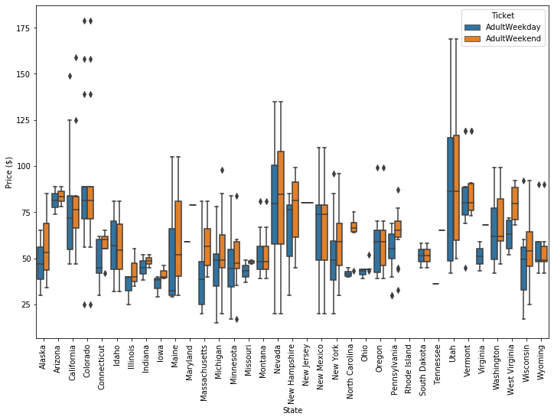
Key Findings
Ticket Price
Current Ticket Price $81.00
Expected Ticket Price $94.22
While this is high for Montana it is still far from the highest pricing across our peers
Weekend Ticket price was predicted, though typically there is no difference in Montana

Slide 4
Model Choice
Exploratory Analysis
Principal Component Analysis
Linear Regression
Inclusion of State Geographic and Demographic Data (no relationship found)
Models tried:
Linear Regression
Better than simple mean model
Random Forest Regressor
Better than Linear Regression using 8 features

Slide 5
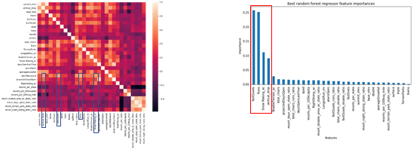
Key Factors
The amenities that drive ticket prices in our model are:
number of fast Quad lifts
number of runs
acreage with snow making capability
total vertical drop for the mountain.

Slide 6
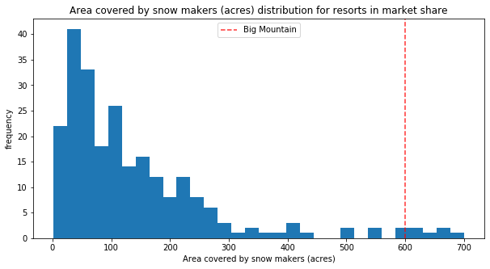
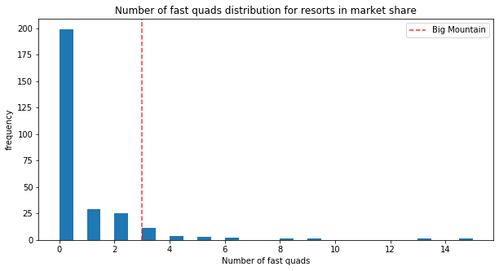
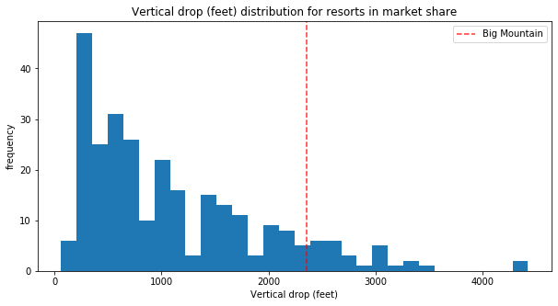
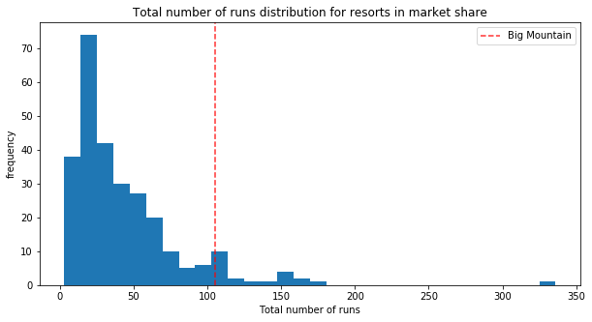
Key Factors

Slide 7
Summary
Ticket Price
Increase Ticket Price to $94.22
Scenarios:
Closing runs reduces revenue in stages with plateaus in reduction between 3-5 runs and 6-8 runs
Increasing the vertical drop of the resort by 150 ft would increase expected ticket price by about $2
Increasing snow making by 2 acres to accommodate the additional 150 ft would not affect the $2 ticket price increase
Increasing the longest run by 0.2 miles and adding 4 ac of snow making would not affect expected ticket price

